Slide 1

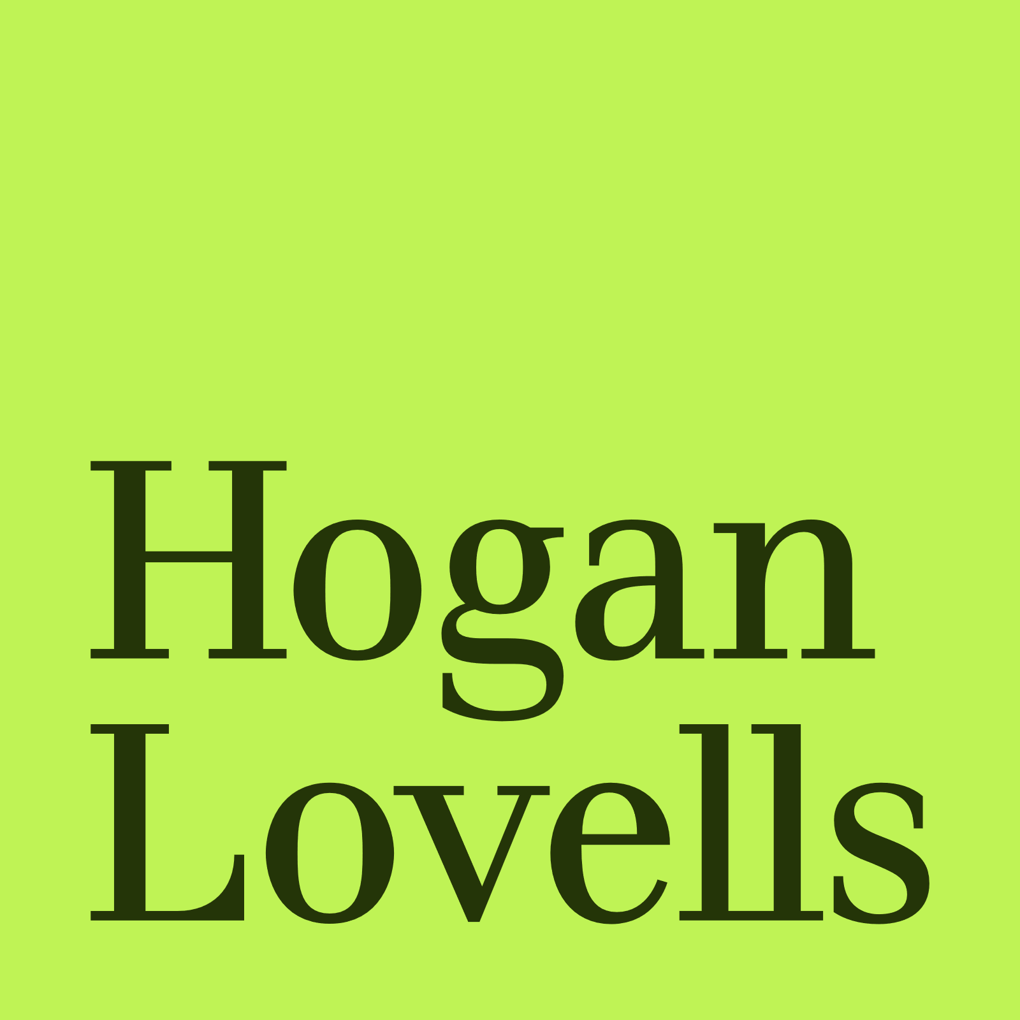
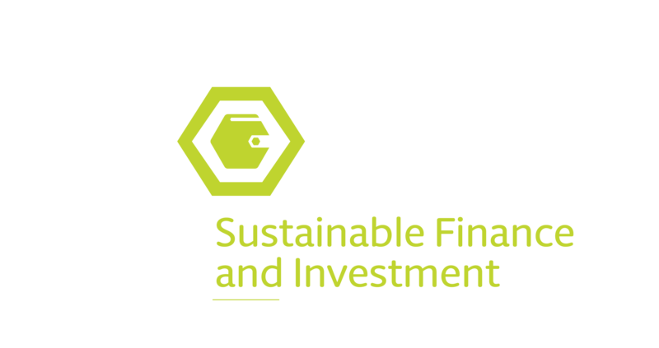
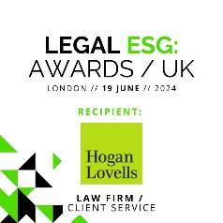
Sustainable Finance
& Investment
September 2024

Slide 2
Our Global Sustainable Finance & Investment Practice
Our global Sustainable Finance & Investment group brings together a multidisciplinary global team that provides clients with best-in-market support. We help our clients stay ahead in this rapidly evolving sector, from a transactional and regulatory perspective, by delivering regulatory advice, products and solutions to assist them in both overcoming challenges and exploiting the vast range of opportunities in this area.
Key services
Advising on ESG investment and sustainability policies, ESG strategy, reporting and disclosure and ensuring alignment with corporate strategy and business operations
Advising on the rapidly changing regulatory environment for sustainable finance and investment (including EU SFDR, Taxonomy Regulation, CSRD, UK SDR and other ESG legislation from other jurisdictions)
Establishing sustainable investment funds, including Article 8 and Article 9 funds, impact funds and hybrid transactions
Working with trade associations and organisations (with the Loan Markets Association, Borsa Italiana, ISDA, TheCityUK, GBBC Digital Finance, ELFA, UN Global Compact and others) to develop market guidance and advising on ESG market practices and standards, voluntary codes and goals
ESG due diligence and disclosure advice in the context of debt offerings, client and/or investment portfolio strategy analysis and acquisitions and disposals
Working across Hogan Lovells finance practices and sectors on sustainable finance transactions including green, social, blue and sustainability-linked loans and bonds, ESG fund finance, ESG securitisation, ESG derivatives, ESG trade finance, blended finance, natural capital investment structures and impact finance and investments
Connecting clients, organisations, foundations and enterprises across our network and raising awareness of issues and opportunities
Advising on risk, potential disputes and legal issues including greenwashing, misrepresentation and advertising, regulatory enforcement, class actions, director’s duties and competition-related matters
Our clients operate across jurisdictions and cultures. We enable them to navigate a volatile and evolving regulatory landscape which is informed by political headwinds. Be that in regulatory compliance or structuring innovative solutions for financial products. We understand that sustainable finance is not a discrete topic and we consider developments in other areas, such as digital, to give truly innovative advice.
We help our clients to understand the ever-growing number of voluntary and mandatory disclosure regimes which apply to their businesses and products. Our clients value targeted regulatory horizon-scanning and clear explanation of how new regulatory developments affect them. We help our clients with regulatory scoping exercises and jurisdictional comparisons. Combined with our practical experience in regulatory compliance and interoperability across a number of jurisdictions we also aid clients in drafting voluntary and mandatory sustainability disclosures. Clients use our online tools to stay up to date with developments.
Our clients, and the products and services they offer, play a vital role in delivering key climate and sustainable development goals and policies such as those set out in the Paris Agreement, the Kunming-Montreal Global Biodiversity Framework, the UN Sustainable Development Goals and national net zero commitments. The role of our lawyers towards these goals is two-fold: supporting our clients with innovative legal advice on transactions and also contributing to the development of the sector. We have collaborated on industry initiatives globally and continue to develop our people’s awareness, education and training. Our lawyers in this space are dedicated to sharing expertise and best practice insights and enabling our clients to navigate the complex, wide-ranging set of issues when considering sustainable finance and investment.

Slide 3
Our Experience
Our Sustainable Finance & Investment clients are predominantly in highly regulated sectors, including financial services, life sciences, tech and energy - we utilise a multidisciplinary approach, that draws in global regulatory and government public policy expertise to work alongside the core transactional and advisory teams. This helps our clients manage ESG risks and maximise the opportunities for long-term sustainable profits and positive impact.
Enel Group on its US$2 billion sustainability-linked Yankee 144A bonds.
Ferrovie dello Stato Italiane on its €3.5 billion sustainability-linked revolving credit facility.
Asset managers, PE, infrastructure and real estate fund managers on the implementation of the SFDR and EU Taxonomy and drafted pre-contractual and periodic annexes and entity-level disclosures.
Helping clients to uplift their funds to Articles 8 and 9 under SFDR.
Clients across multiple sectors on the scope, applicability and implementation of the CSRD and EU Taxonomy, including various U.S. listed and headquartered global companies.
The Central America Bottling Corp. on its inaugural US$1.1 billion sustainability-linked bond offering.
Enpal on Securitization of Solar Loan Receivables of up to €356 million for first German residential solar ABS.
UK asset managers on the FCA’s SDR and investment labels regime, anti-greenwashing rule and TCFD product and entity reporting rules.
Various UK companies and asset managers on mandatory TCFD reporting requirements and reviewed disclosures.
Various clients on the CSRD ESRS requirements, including on the legal aspects of reporting, double materiality assessments and value chain considerations, including drafting the disclosures.
A forestry fund on its Article 9 SFDR compliance, including in relation to the do no significant harm test and drafting relevant disclosures.
A major international bank in relation to the interpretation and implementation of the SFDR and other related pieces of ESG- related regulation.
A club of banks on the refinancing (by way of sustainability linked-loan) of the Nuffield Health group's existing term and revolving facilities and repayment of private placement notes.
Bayerische Landesbank as arranger, ABN AMRO Bank, DZ Bank, Natixis and UniCredit on the world’s first placement of a Blue Social Bond of Deutsche Kreditbank for the refinancing of the municipal water supply and sanitation business in Germany.
A leading French investment bank on its ESG structured products programme including regulatory requirements and risk management under MiFID II.
The Carbon Trust on the establishment of their Green bond and Climate bond third-party verification business.
Affinity Water in relation to various sustainability-linked loans at different levels in their structure which includes KPIs developed to align to key UK water sector sustainability strategy.

Slide 4
hoganlovells.com
“Hogan Lovells” or the “firm” is an international legal practice that includes Hogan Lovells International LLP, Hogan Lovells US LLP and their affiliated businesses.
The word “partner” is used to describe a partner or member of Hogan Lovells International
LLP, Hogan Lovells US LLP or any of their affiliated entities or any employee or consultant
with equivalent standing. Certain individuals, who are designated as partners, but who are not members of Hogan Lovells International LLP, do not hold qualifications equivalent to members.
For more information about Hogan Lovells, the partners and their qualifications,
see www.hoganlovells.com.
Where case studies are included, results achieved do not guarantee similar outcomes for other clients. Attorney advertising. Images of people may feature current or former lawyers and employees at Hogan Lovells or models not connected with the firm.
© Hogan Lovells 2024. All rights reserved.

